Slide 1

Prediction of LC50 value using Quantitative structure activity relationship models (QSAR models)
DEBASISH mOHANTY

Slide 2
Objective
The problem addressed in this project is to develop robust and accurate QSAR models for predicting the LC50 value, a measure of the concentration of a substance that causes 50% mortality in test organisms, of potentially hazardous chemical compounds.
The proposed solution for the problem involves the development and evaluation of QSAR models based on molecular descriptors to predict LC50 values. The models will be trained on a dataset of compounds with known LC50 values and molecular descriptors. The performance of the models will be evaluated using statistical measures such as correlation coefficient, root mean square error, and coefficient of determination. The resulting models can be used to predict the toxicity of new compounds, which can be useful in environmental risk assessment, and chemical safety evaluation.

Slide 3
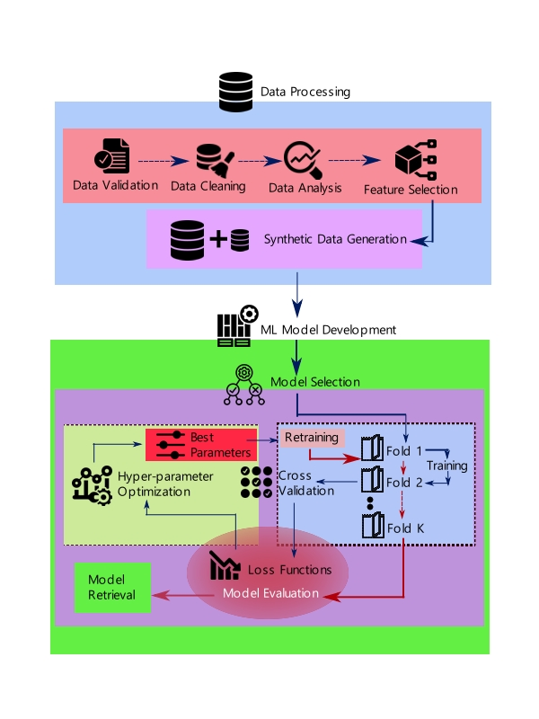
Architecture

Slide 4
Data -> Preprocessing and Transformation
dAta type | Null values | Synthetic data | Encoding and scaling
All the data was in numerical. To be precise, the datatype was float32 for all.. | Considering the number of datapoints, there was no nullvalues in collected data. | New data points were created by introducing gaussian noise to the raw data. | As all columns are numeric, no encoding is used.
 |  | SMOGN algorithm is used to add extra 20% to the initial dataset. | Standard and min-max scaler is used iteratively for testing.

Slide 5
Data -> Storage and Retrieval
Due to small size of data, data is stored in local as csv file.
During training and evaluation a lot of data are retrieved about hyper-parameter optimization, model evaluation, loss functions, and time deltas.

Slide 6
ML Development
•Model Implementation
Following the division of the dataset into training and testing subsets, a pipeline encompassing a Standard Scaler was employed to train multiple models, including XGB Regressor, Logistic Regressor, K Neighbour Regressor, and Random Forest Regressor.
•Cross-Validation Setup
To mitigate the risk of overfitting during the model training phase, we implemented a robust cross-validation setup.
•Hyper-Parameter Optimization
In order to optimize the hyperparameters of our models, we employed the sophisticated Optuna framework. Our approach involved defining an objective function that was executed for a sample run with a random fold, allowing us to identify the best hyperparameters.
•Model Evaluation
The test dataset, constituting 1/15th of the overall dataset, was employed to assess the performance of the model. The hyperparameter optimization process focused on minimizing the root mean square error (RMSE) as a measure of accuracy.

Slide 7
Deployment
1. Frontend with ReactJS
In this project, the user interface (UI) was developed using ReactJS, a JavaScript library. The front-end implementation involved the creation of a robust framework to facilitate the communication with the backend through API endpoints.•Cross-Validation Setup
2. Backend with FastAPI
The backend API for this project was implemented using the FastAPI framework, renowned for its efficiency and performance.
3. Deployment on Cloud
The fully operational code was obtained from the code repository using Git and deployed on an AWS EC2 instance. It can be found at -
http://ec2-43-204-230-6.ap-south-1.compute.amazonaws.com:3000/

Slide 8
Application Perspective
The devised model will possess the capacity to forecast the LC50 value based on six molecular descriptors, thereby delineating the magnitude of toxicity within an ecosystem. By employing Quantitative Structure-Activity Relationship (QSAR) models, this capability is harnessed through the utilization of meticulously formatted and pristine data. The applications of this project encompass the determination of environmental conditions and the monitoring of fluctuations in the LC50 value, as per the specified requirements.

Slide 9
Q & A
Q1) What’s the source of data?
The data was collected from ECOTOX Knowledgebase website as excel file.
Q 2) What was the type of data?
Initially the data was of string data type, after proper formatting the numeric values of data are used.
Q 3) What’s the complete flow you followed in this Project?
Refer slide 3rd for better Understanding
Q 4) After the File validation what you do with incompatible file or files which didn’t pass the validation?
Considering singularity of the provided file, incompatibility was not an issue.

Slide 10
Q & A
Q 5) How logs are managed?
Logs were managed using “logging” module in python. The logs are mostly stored for training and validation of the ML models. Logs are available in the git repo.
Q 6) What techniques were you using for data pre-processing?
Visualizing relation of independent variables with each other and output variables
Checking and changing Distribution of continuous values
Cleaning data and imputing if null values are present
Generating suitable amount of synthetic data for better accuracy
Scaling the data using different scalers
Distributing the data into number of folds for cross-validation

Slide 11
Q & A
Q 7) How training was done or what models were used?
Training was done initially on local system. After the confirmation of least error, the code was transferred to kaggle, and ran over GPUs for XGB and cpu for other models.
The applied alogirthms were XGBR, KNN, Decision Tree, Linear Regression, Random Forest, and SVR.
Q 8) How Prediction was done?
For prediction part, the deployment on web can be useful to predict the level of toxicity based on molecular descriptor values as indicator.

Slide 12
Q & A
Q 9) What are the different stages of deployment?
After testing the model with sample data, we created the API using FastAPI framework. The frontend was developed using React framework with axios for API calls. Finally the web app is deployed on AWS EC2 linux instance and allowed on required ports for required interaction. The deployment is tested on given DNS of AWS EC2 instance.

Slide 13
THANK YOU

